Slide 1
Human vision
Jitendra Malik
U.C. Berkeley

Slide 2
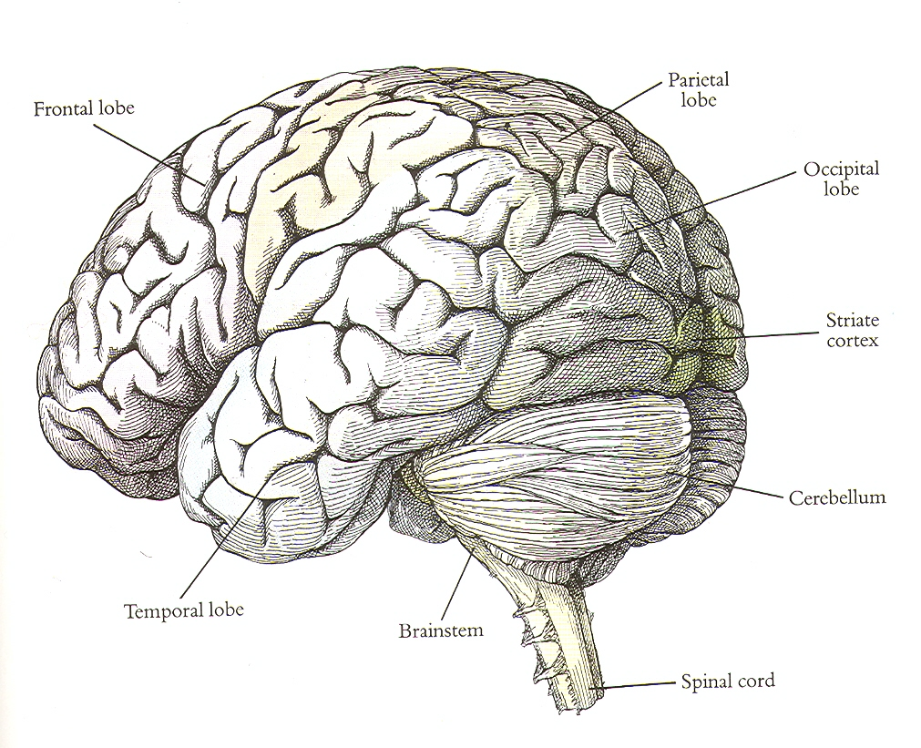

Slide 3
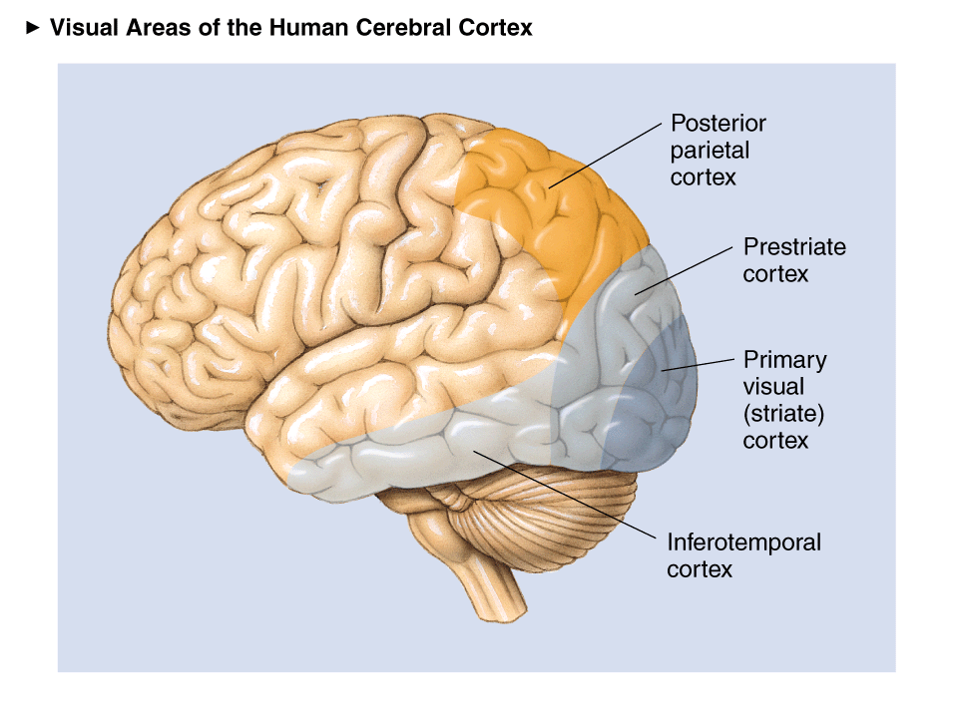
Visual Areas

Slide 4
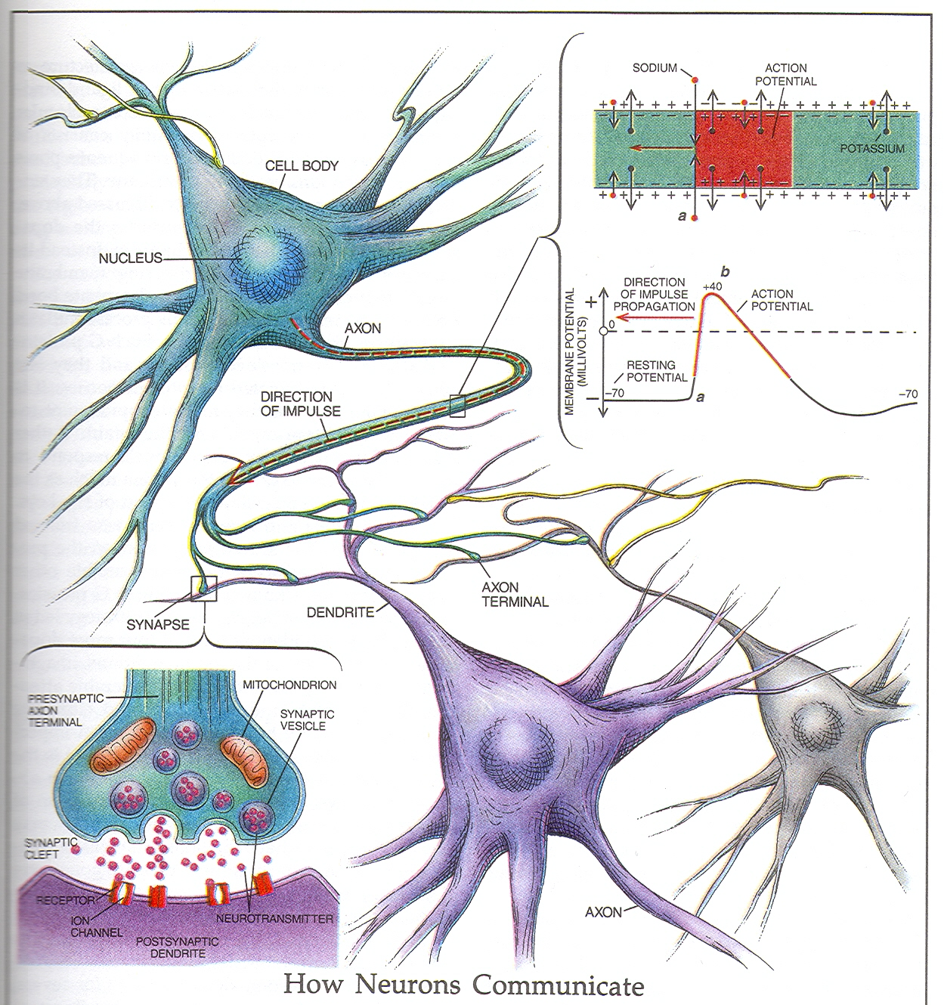

Slide 5
Mathematical Abstraction

Slide 6
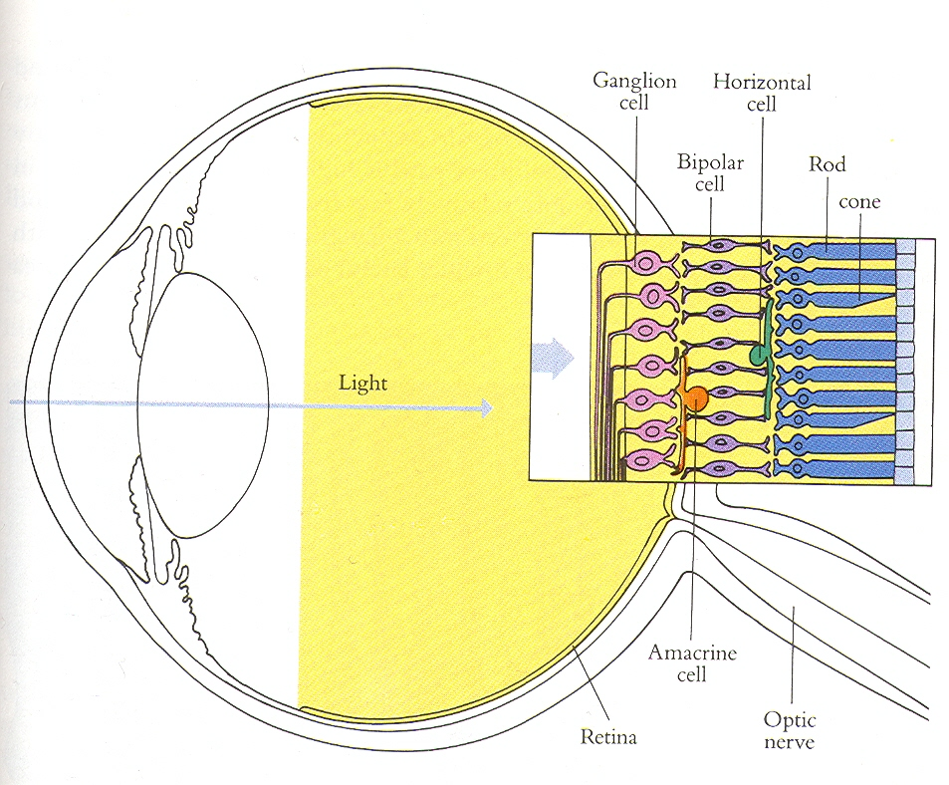

Slide 7
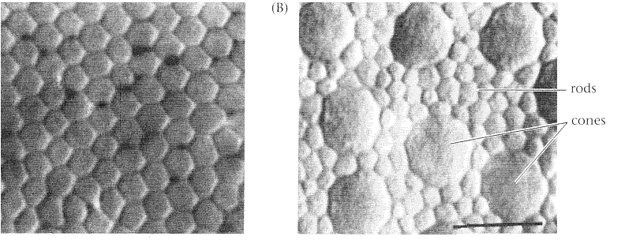
The photoreceptor mosaic: rods and cones are the eye’s pixels

Slide 8
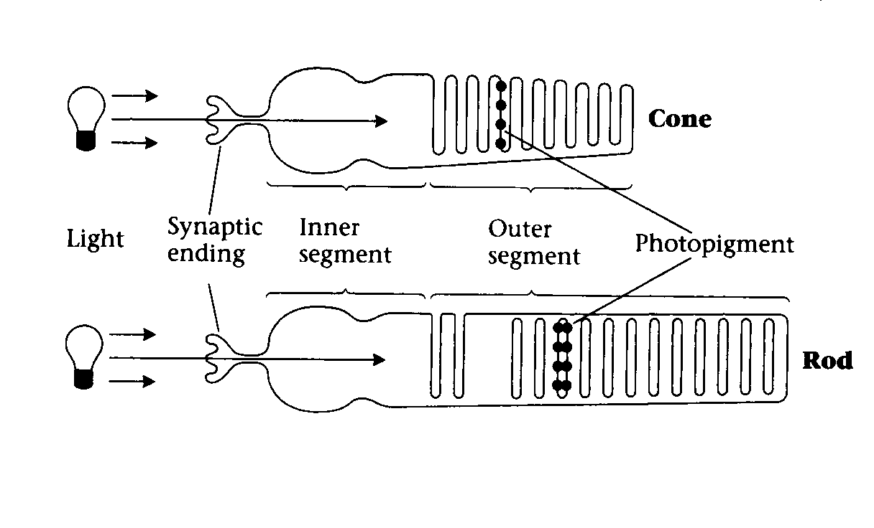
Cones and Rods
After dark adaptation, a single rod can respond to a single photon

Slide 9
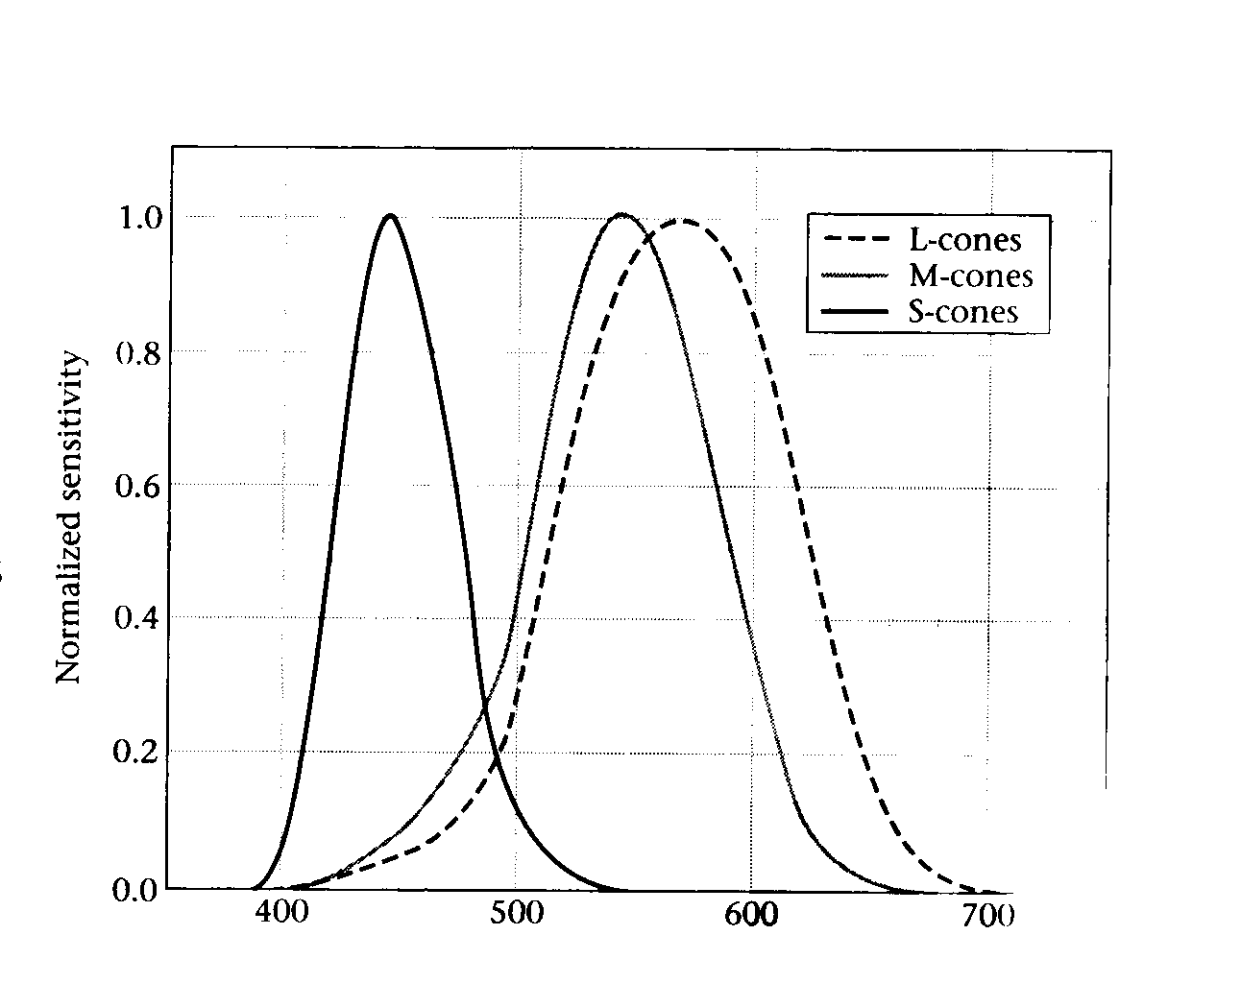
The three cone types have different spectral sensitivity functions

Slide 10
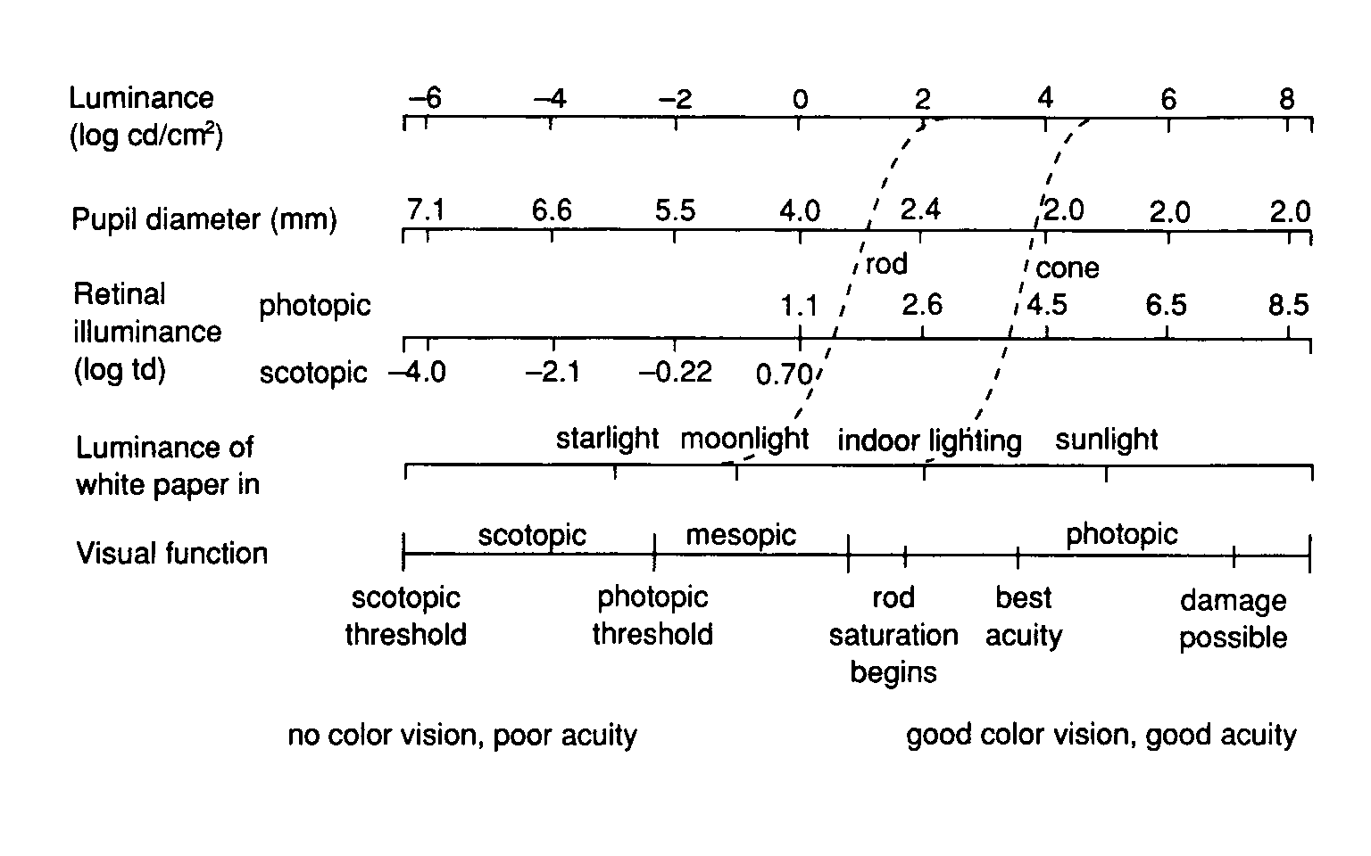

Slide 11
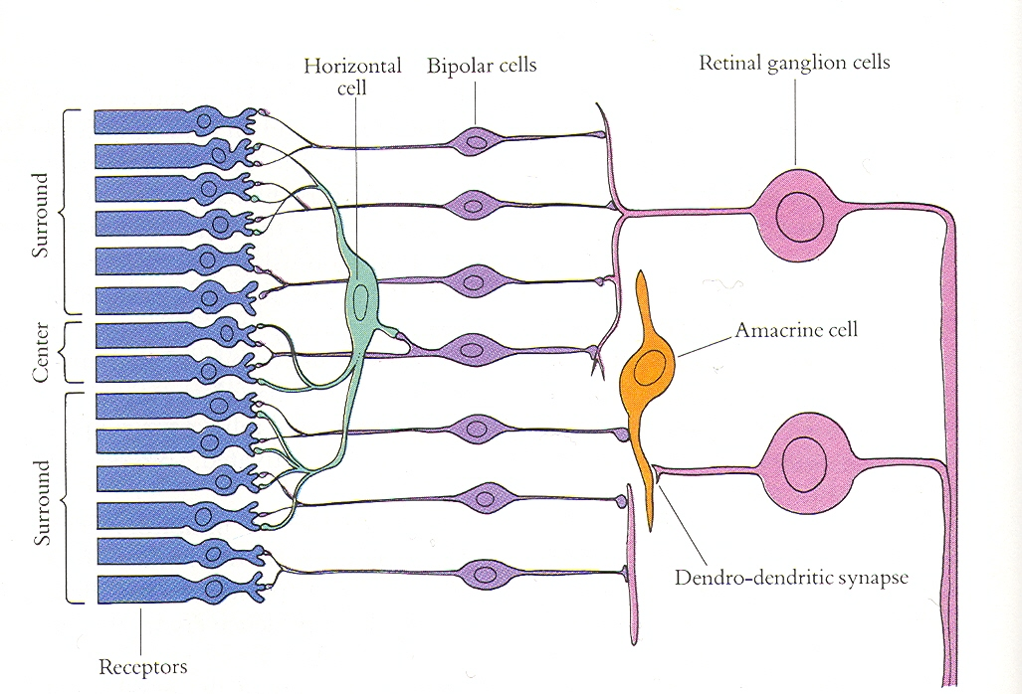

Slide 12
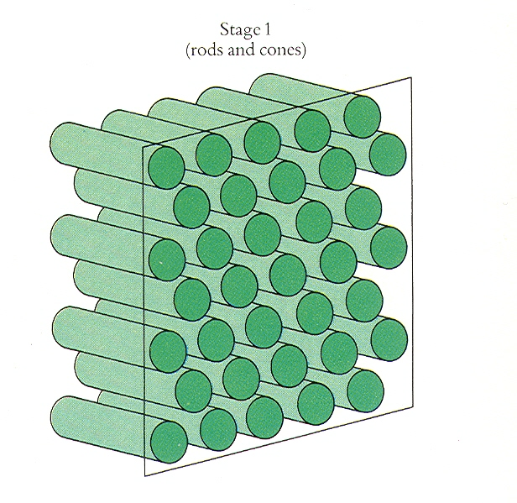

Slide 13
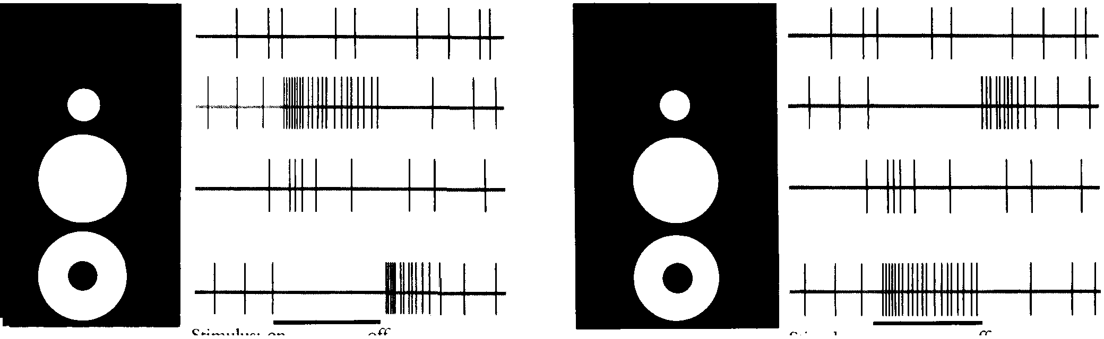
ON and OFF cells in retinal ganglia

Slide 15
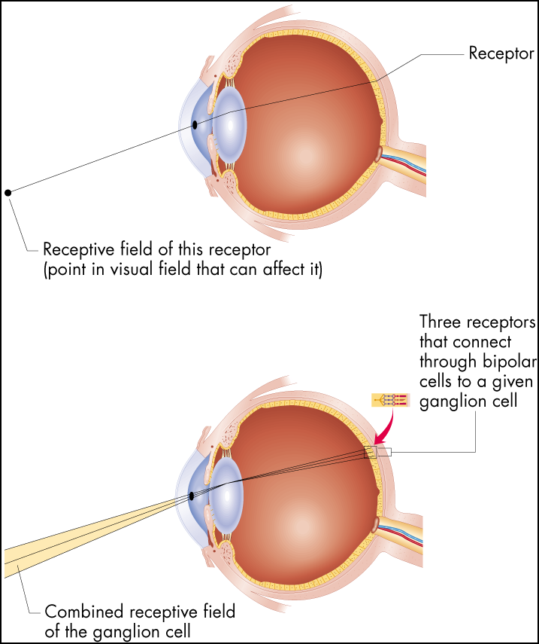
Receptive Fields
Figure 6.16 Receptive fields
The receptive field of a receptor is simply the area of the visual field from which light strikes that receptor. For any other cell in the visual system, the receptive
field is determined by which receptors connect to the cell in question.

Slide 16
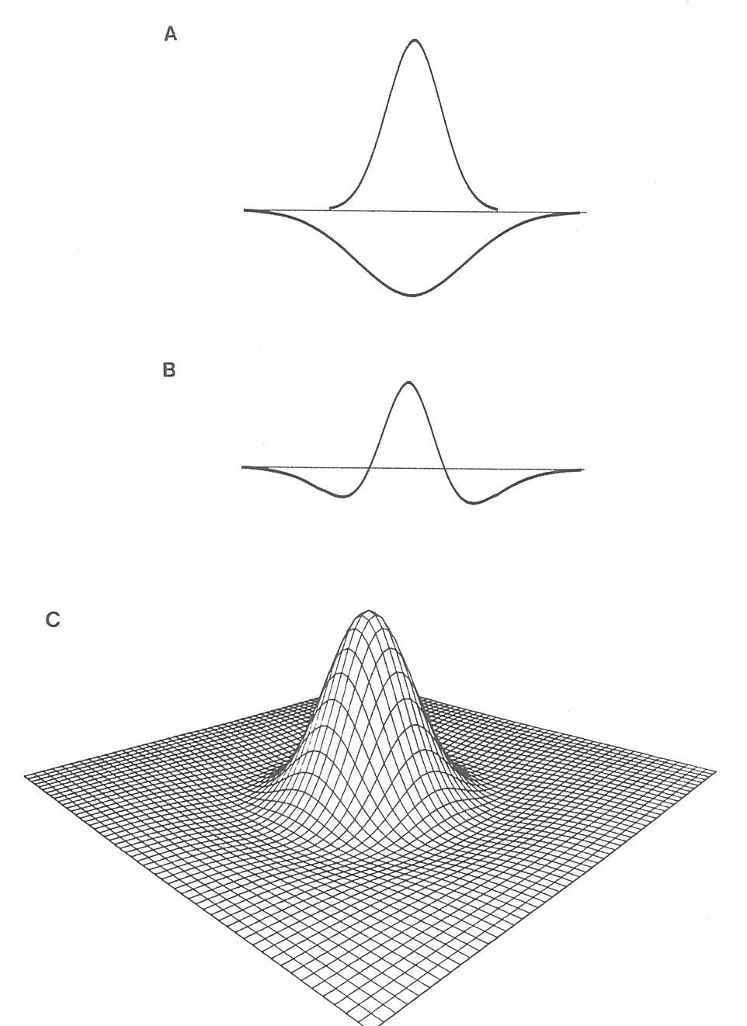
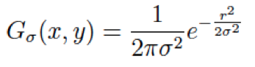
The receptive field of a retinal ganglion cell can be modeled as a “Difference of Gaussians”

Slide 17
Convolving an image with a filter

Slide 18
Each output unit gets the weighted sum of image pixels

Slide 19
Each output unit gets the weighted sum of input units
We can think of this weighting function
as the receptive field of the output unit

Slide 20
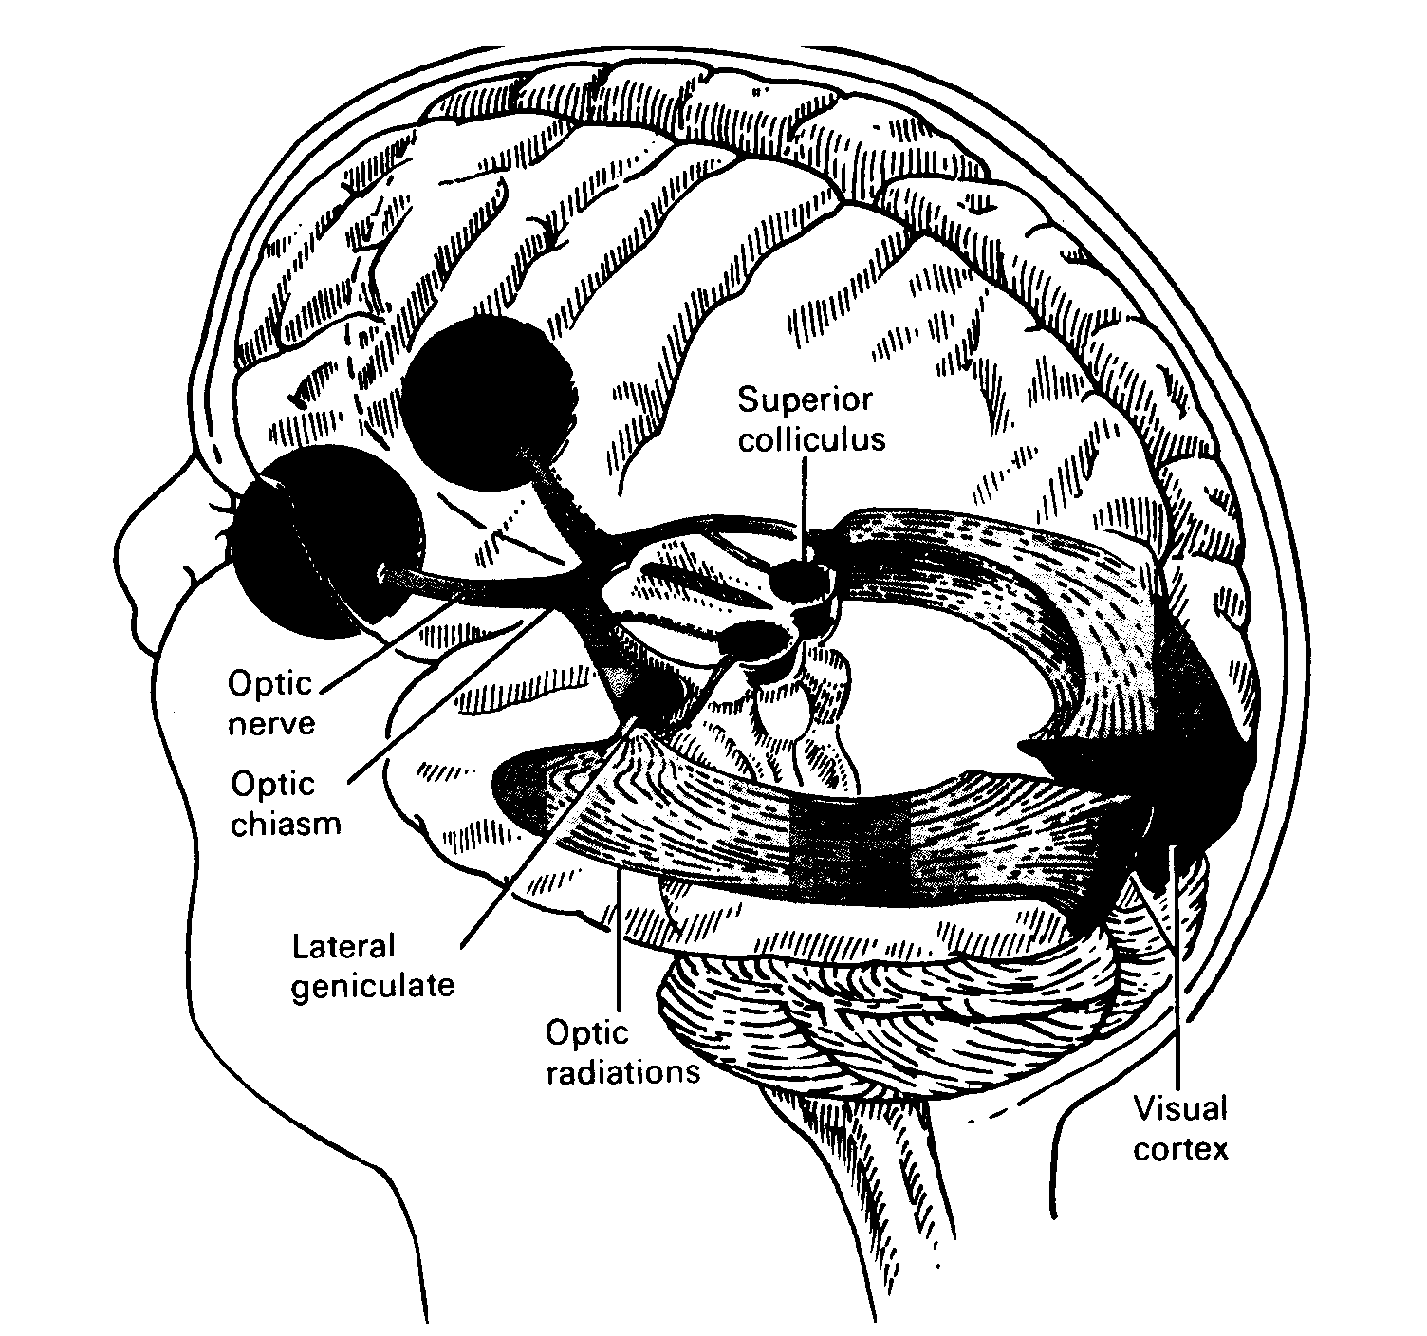

Slide 21
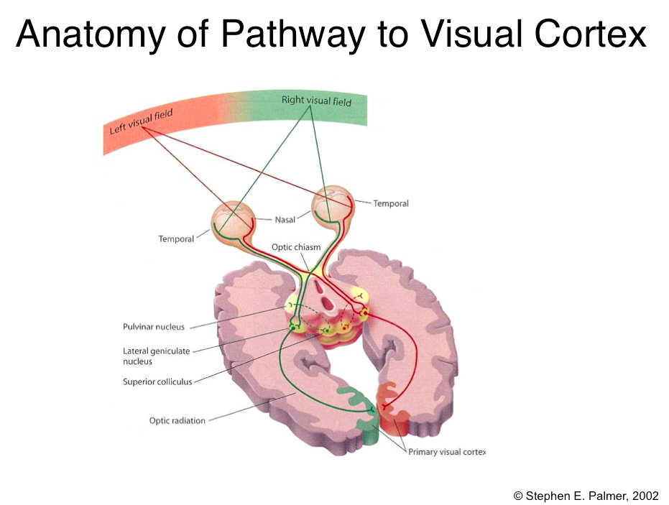

Slide 22
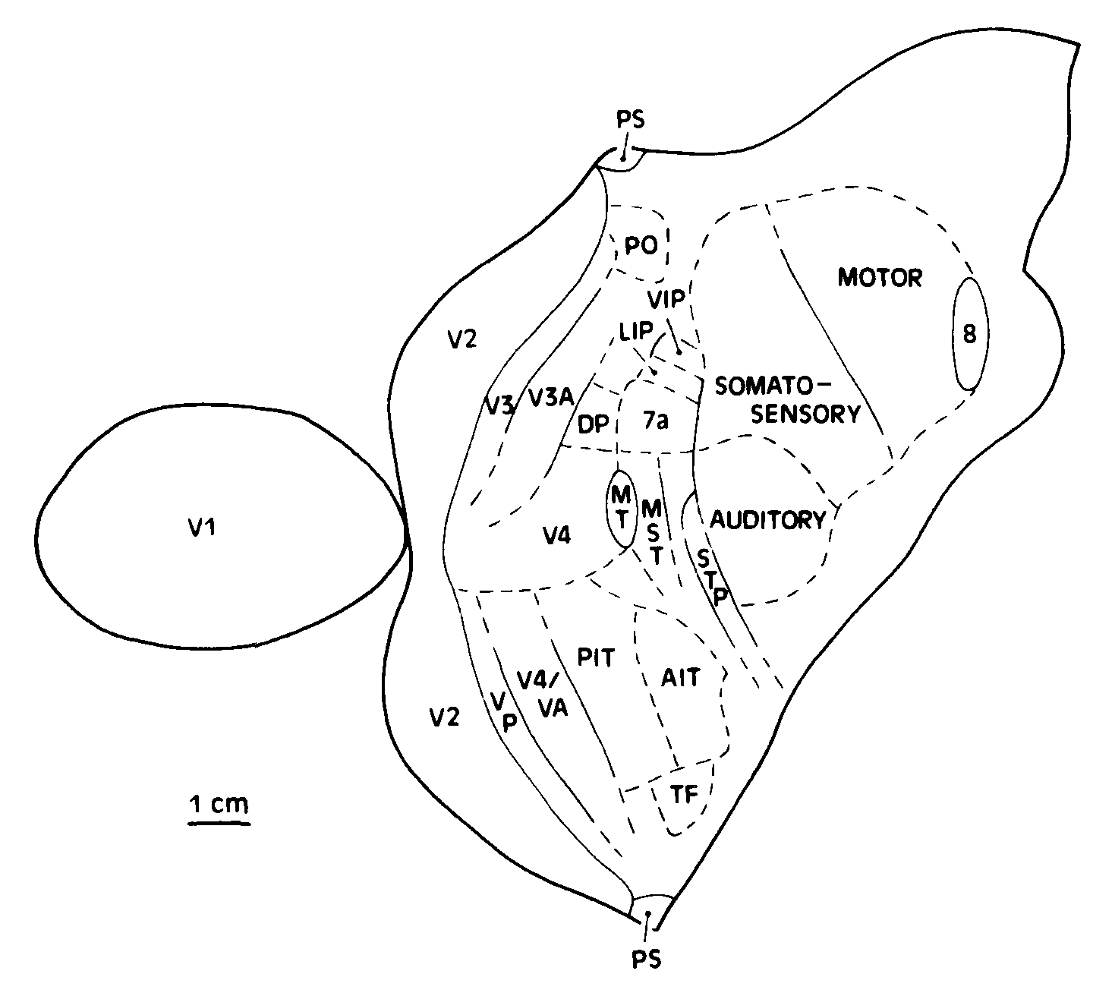
Visual Processing Areas

Slide 23
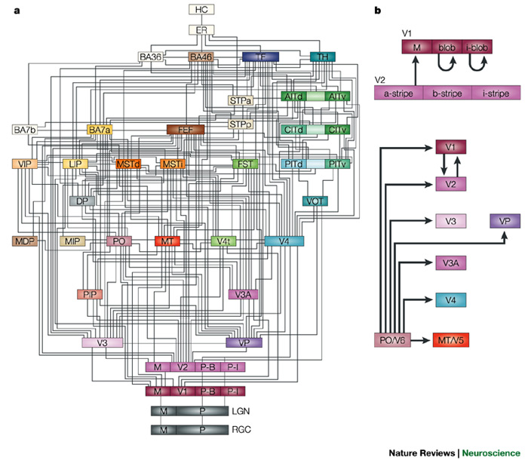
Macaque Visual Areas

Slide 24
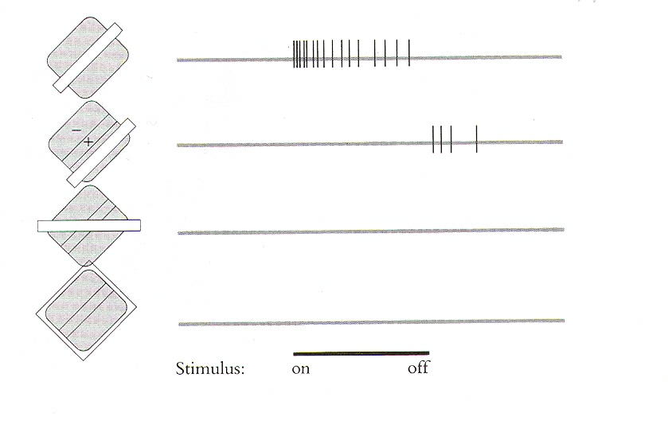
Orientation Selectivity in V1

Slide 25
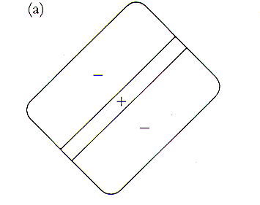
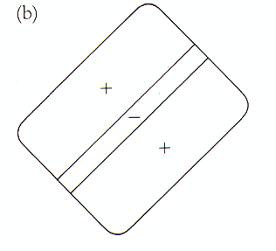
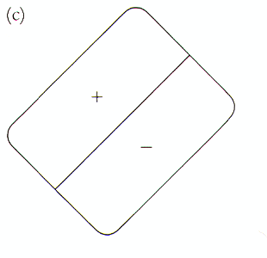
Receptive fields of simple cells (discovered by Hubel & Wiesel)

Slide 26
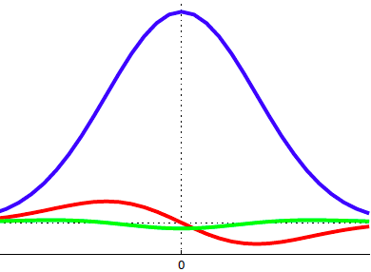
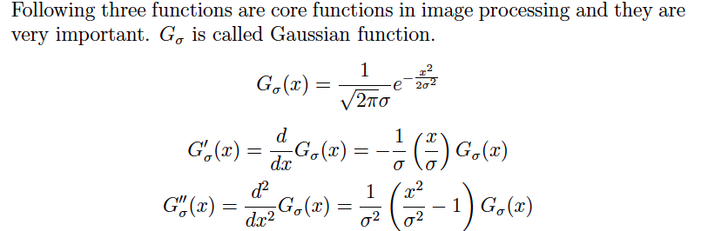
The 1D Gaussian and its derivatives

Slide 27
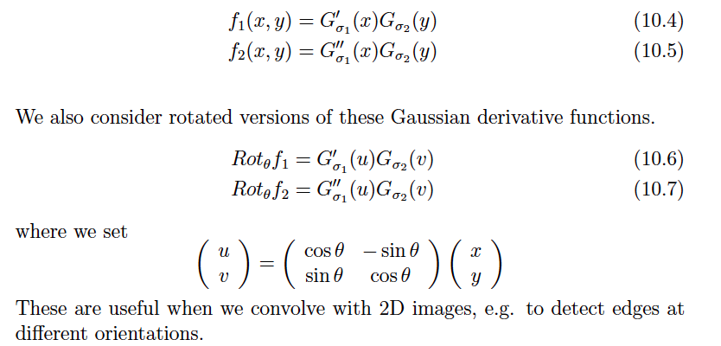
Oriented Gaussian Derivatives in 2D

Slide 28

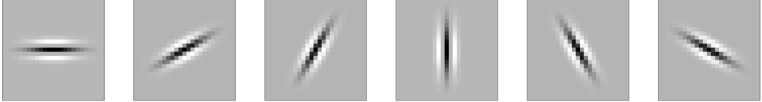
Oriented Gaussian First and Second Derivatives

Slide 29
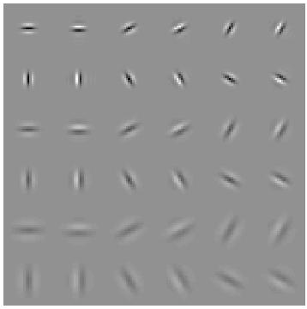
Modeling simple cells
Elongated directional Gaussian derivatives
Gabor filters could be used instead
Multiple orientations, scales
Notes:
No response to intensity ramps -- important benefit compared to simple comparison of intensities at i and j

Slide 30
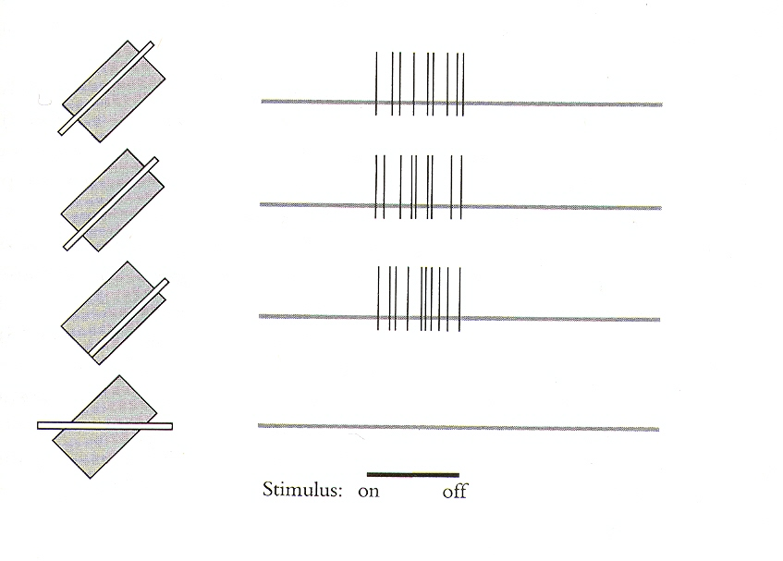
Receptive fields of complex cells

Slide 31
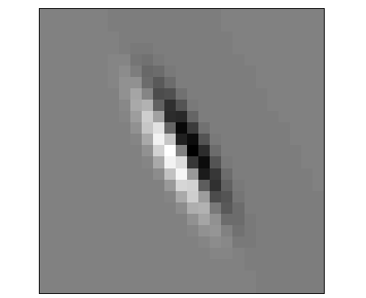
Orientation Energy
Can be used to model complex cells, as this is insensitive to phase
Multiple scales

Slide 32
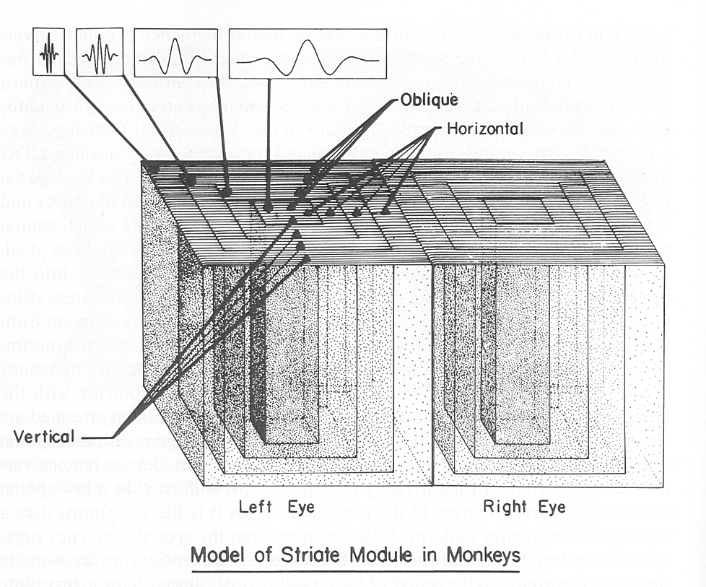
Hypercolumns in visual cortex

Slide 33
Macaque Visual Areas

Slide 34
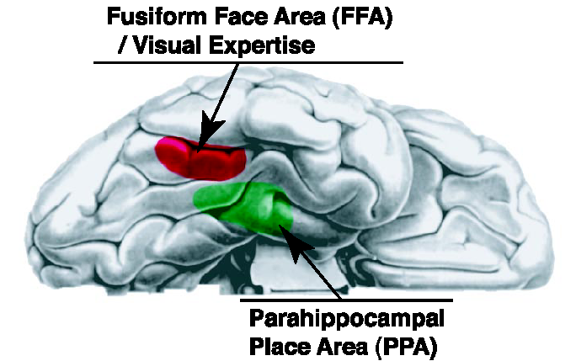

Slide 35
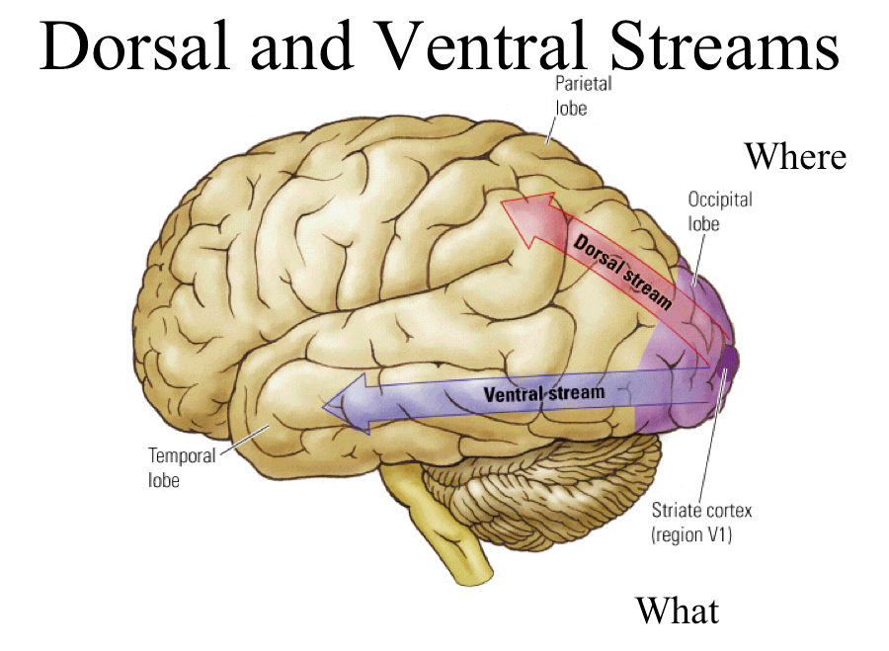

Slide 36
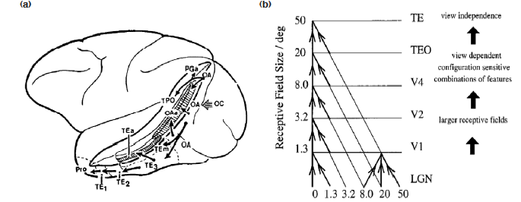
Rolls et al (2000) model of ventral stream

Slide 37
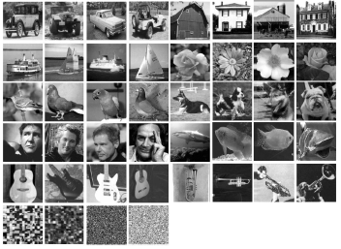
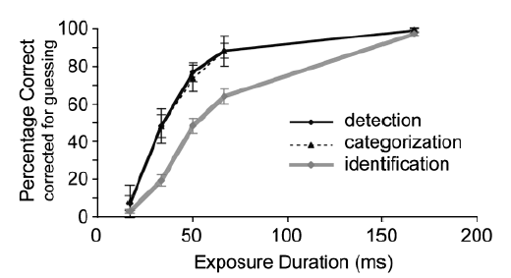
Object Detection can be very fast
On a task of judging animal vs no animal, humans can make mostly correct saccades in 150 ms (Kirchner & Thorpe, 2006)
Comparable to synaptic delay in the retina, LGN, V1, V2, V4, IT pathway.
Doesn’t rule out feed back but shows feed forward only is very powerful
Detection and categorization are practically simultaneous (Grill-Spector & Kanwisher, 2005)

Slide 38
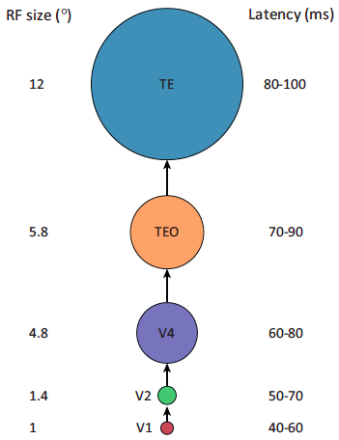
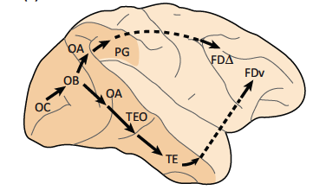
Feed-forward model of the ventral stream

Slide 39
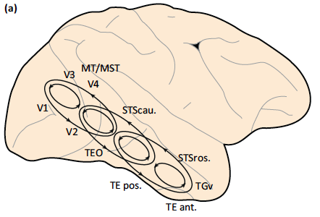
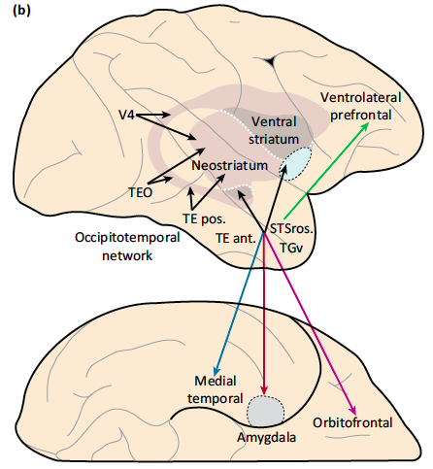
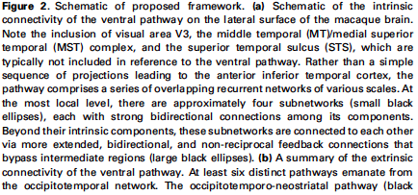
Intrinsic & Extrinsic Connectivity of the Ventral Stream (Kravitz, Saleem, Baker, Ungerleinder, Mishkin, TICS, 2013)

Slide 40
What can we learn?
Neurons show increasing specificity higher in the visual pathway
V1 simple and complex cells are orientation-tuned
Convolution with a linear kernel followed by simple non-linearities is a good model for computation in retina, LGN and V1, but beyond that we do not have satisfactory computational models
Good designs of visual systems are likely to be hierarchical and “mostly” feedforward
Notes:
No response to intensity ramps -- important benefit compared to simple comparison of intensities at i and j

Slide 41
Neuroscience & Computer Vision Features
Hubel & Wiesel’s finding of orientation selective simple and complex cells in V1 inspired features such as SIFT and HOG.
A feed-forward view of processing in the ventral stream with layers of simple and complex cells led to the neocognitron and subsequently convolutional networks.
We now know that the ventral stream is much more complicated with bidirectional as well as feedback connections. So far this has not been exploited much in computer vision

Slide 42

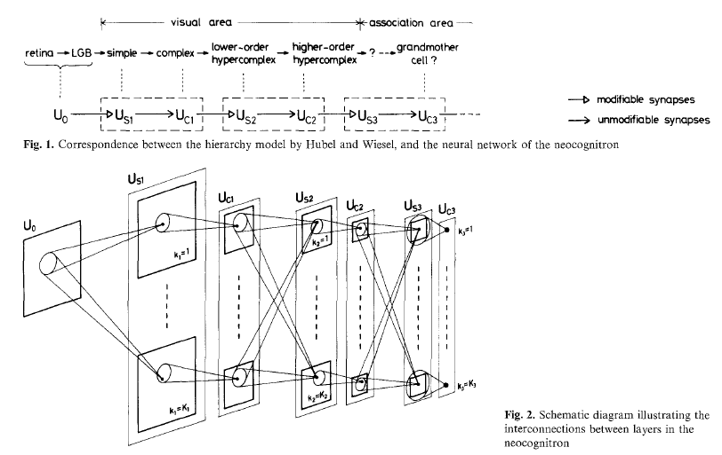

Slide 43
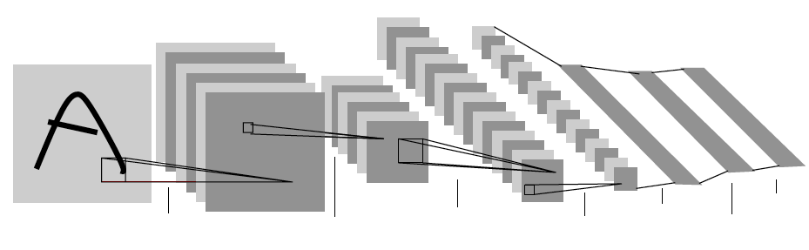
Convolutional Neural Networks (LeCun et al)

Slide 44
Convolutional Neural Networks (LeCun et al)

Slide 45
Training multi-layer networks

